Slide 1
Keys to Effective Use of Email
Presented by Mark Carson
Impact Jewelry Selling Workshop
Brought to you by the Hawaii Jewelers Association
Copyright 2014, Mark Carson

Slide 2
General
Keys to Effective Use of Email
It's Business Correspondence
It’s not texting or tweeting. Don’t use “U” for “you” or “2” for “to”, etc.
Write in complete sentences.
Limit the number of fonts used (so your email won’t look like a ransom note).
Use fonts that are both common and easy to read
Use “Variable” or “Fixed” width options in your email program rather than a named font.
Named fonts: Helvetica/Arial (san serif), Times Roman (serif) or Courier (fixed width).
Avoid obscure fonts the recipient may not have.
Avoid fancy but hard to read fonts (like cursive or old English fonts).
Be Courteous and Professional
Spelling and Punctuation Matter
Proofreading is time well spent.
Legal Ramifications
In the case of legal disputes, email may be used as evidence of what you said. So be careful what you say or promise in emails.
Emails may be sent on to others without your knowledge or consent. Don’t consider your statements to be private as they may end up being made public.

Slide 3
Heading
Keys to Effective Use of Email
From Line
Use an email address from a credible source.
An email address with your company's name is best.
If your company does not have a good email address, recommend that they get one (and a matching website too).
Avoid sending from public email service accounts (Hotmail, Gmail, Yahoo, etc.)
A good From Line: Bill.Smith@QualityJewelers.com
A bad From Line: billyBoy456@yahoo.com
If recipients do not recognize you via the From line, they may delete the email without reading it.

Slide 4
Heading - continued
Keys to Effective Use of Email
To Lines
To – the primary recipients or actionees
Cc – Carbon Copy – additional recipients or infoees
Bcc – Blind Carbon Copy – additional recipients whose names do not appear to other recipients of your email
Subject Line
Never, ever, send an email with a blank Subject
Be descriptive
Avoid phrases that get your email sent to a Trash Folder

Slide 5
Body
Keys to Effective Use of Email
Salutation – greet your recipient by name whenever possible.
Open with a thank you to the recipient whenever possible.
Briefly recap situations or previous communications to provide context to your email.
Acronyms and Abbreviations
If you are not 100% sure acronyms and abbreviations will be known by the recipient, spell them out on their first use (followed by the abbreviation or acronym in parentheses).
For example,” The Hawaii Jewelers Association (HJA) welcomes you to this event. The HJA is your partner in sales.”
The essence of the communication needs to be in the body of the email.
Do not simply write “Refer to the attached” in lieu of stating why you are communicating with the recipient.
Mention briefly what is in your attachments (if there are any).
Clearly state any actions that need to be performed by the recipient.
Clearly state what you have done, what you are prepared to do, or what you future actions will be.
Do not be ambiguous or leave matters “up in the air”. State what you are prepared to do or not do.

Slide 6
Closing
Keys to Effective Use of Email
Your name (and title when appropriate)
Business Name
Date (the time is optional but a good idea also)
If your recipients may not be in the U.S., be mindful of various international date formats.
05/12/14 (U.S. – day/month/year)
12/05/14 (Europe – month/day/year)
2014-12-05 (ISO 8601 – used in Japan, etc.)
Recommend using an unambiguous format where the month and date won’t be confused and the year is expressed using 4 digits (not 2).
12-MAY-2014
Your email address
Additional Contact Information (optional but recommended)
Additional email address
Telephone numbers
Website
Facsimile
Text/Chat
Social Media (Facebook, Twitter, etc.)

Slide 7
Attachments
Keys to Effective Use of Email
Total Size
2 MB or less unless you have prior permission from the recipient(s).
Graphics
File size and Resolution Issues.
Unless there is a real need, do not send image larger than screen sizes.
Cameras (including cell phones) take huge photos these days.
When possible, resize images keep the file size down and to also make the entire image easier to view without scrolling on a computer monitor, tablet or cell phone screen.
JPG – universally supported but use a reasonable compression factor.
GIF - universally supported but they only support 256 unique colors.
Other formats – support may vary for other graphic file formats. Only use those you are sure that your recipients will be able to view or use.

Slide 8
Attachments - continued
Keys to Effective Use of Email
Documents
Only use document file types for which your recipients have viewing applications. Don’t send people things they can’t open. Don’t assume everyone has the same applications that you do.
Microsoft Word
“Save As” using older version formats if there is any doubt that your recipients have the latest version of Word. For example, MS-Word 97 format is widely supported while some people can not read MS-Word 2013 files as they have older versions of MS-Word or non-Microsoft viewers.
PCs, Macs, tablets and phones can all receive email but their attachment file format support varies.
Adobe Portable Document Format (PDF)
Use JPG or GIF files if your PDF would only contain a single (raster) image.
Instead of scanning printed pages and saving them as PDF files, consider scanning and saving as black & white GIF files.

Slide 9
Email Functions
Keys to Effective Use of Email
Return Receipts
Do not use Return Receipts unless you really need to know that all recipients of your email have received it (with the implication that they have also read it).
Overuse of Return Receipts often irritates recipients and serves no purpose in most cases. Only use this option when absolutely needed.
Reply and Reply All
Attachments from the original email are not included in replies.
The original email is often reformatted somewhat.
If the number of back and forth email replies exceeds a reasonable number (like 4 or 5), delete the oldest content from the bottom of your reply.
Forwarding
Forwarding is to send a copy of an email to parties who were not recipients of the original email. Don’t use “Forward” when you are simply replying.
Attachments from the original email are included in forwarded emails.
Additional narrative and attachments may be added.
The original email is often reformatted somewhat.

Slide 10
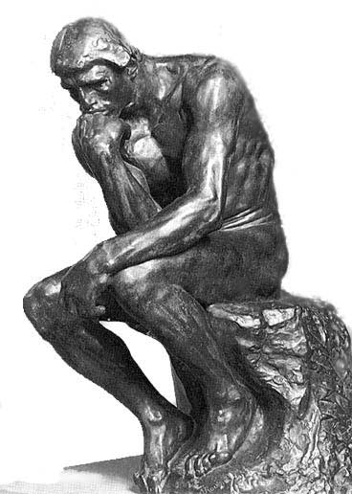
Questions?
Keys to Effective Use of Email
Reuse of this presentation is permitted for Hawaii Jeweler Association members and their employees. Other distribution is only permitted with the prior approval of Mark Carson (Mark@MarkCarson.com)

